Slide 1
AI-DxMH- Artificial Intelligence Diagnosis for Modern Health
FINAL REVIEW
Batch Number: G15
Roll Number | Student Name
202021CAI0138 | Vaishak G Kumar
202021CAI0139 | Abhilash Prusty
202021CAI0093 | MD Fahad Pasha
202021CAI0136 | Dhrupath Rajeev
Under the Supervision of,
Mr. Gnanakumar G
Assistant Professor
School of Computer Science Engineering & Information Science
Presidency University

Slide 2
Introduction
1.1 Problem Statement:
India faces a shortage of doctors, particularly in smaller towns and villages, which hinders access to healthcare for many individuals. Prior attempts at implementing telemedicine and other solutions have struggled to scale due to this problem. In the digital age of voice assistants like Google and Alexa, is it possible to develop an artificial intelligence (AI) doctor that can effectively diagnose common acute illnesses such as the common cold or flu based on simple questions?
Solution:
To address the scarcity of doctors in India's rural areas, our proposed solution involves creating an advanced AI-powered healthcare system. By harnessing Artificial Intelligence (AI), Machine Learning (ML), and Natural Language Processing (NLP), we aim to build an intelligent digital assistant capable of diagnosing prevalent acute diseases like the common cold or flu through user-friendly interactions.
The core technology behind our solution will rely on a sophisticated Large Language Model (LLM) similar to OpenAI's GPT platform. This LLM would be designed specifically for understanding natural language queries from users regarding their symptoms. The AI-based doctor will utilize a heuristic approach by integrating medical knowledge, symptom analysis techniques, and historical data records effectively providing accurate personalized diagnoses tailored towards each individual case scenario.

Slide 3
Literature Review
Application of artificial intelligence in medical technologies :
Introduction:
The use of intelligence (AI), in technology has grown significantly especially in specialized fields such as oncology, pulmonology, cardiovascular medicine orthopedics, hepatology and neurology. This comprehensive review aims to explore the emerging trends in incorporating AI into healthcare practices.
Main Trends:
The review emphasizes areas where AI is making contributions. These include collecting and analyzing data for disease diagnosis well as assisting in active treatment processes. Notably deep learning methods like networks (CNNs) have shown promise, particularly in radiology and oncology by enabling image recognition. The development of AI models that rival the expertise of professionals is particularly noteworthy, in cancer detection highlighting how AI can enhance healthcare capabilities.
Future Developments:
Looking ahead the study calls for advancements to broaden the scope of AI in medicine with a focus on its applications, in surgical procedures. However it acknowledges that there is ambiguity surrounding the concept of AI and recognizes the challenges associated with keeping up with evolving research trends.
Conclusion:
Finally, this systematic review provides a comprehensive overview of the use of artificial intelligence in medical technology and highlights its potential for transforming health care. The findings reinforce the need for continuous efforts to improve integration and use of

Slide 4
Applications of Explainable Artificial Intelligence in Diagnosis and Surgery
Introduction:
First of all, healthcare has undergone a transformation thanks to the growth of medical artificial intelligence (AI) applications, which are driven by deep learning and machine learning. This paper addresses concerns regarding the opaque nature of some AI models and focuses on Explainable AI (XAI) applications in medical diagnostics and surgery.
Using a search from 2019 to 2021, important XAI techniques for medical applications were found. There was discussion of rule-based methods, XGBoost models for choosing laser surgery, and SVM models for surgical training.
XAI Techniques:
The study investigates various XAI techniques. Rule-based methods, which specify the criteria for making decisions, offer transparency. Surgical decision transparency is ensured by the practical application of XAI, as demonstrated by the employment of XGBoost models in laser surgery. SVM models in a surgical education demonstrate XAI versatility in medical education.
Goal and Significance:
Highlighting XAI's importance in healthcare, this concise assessment aims to bridge the gap between medical practitioners and AI.. The review provides guidance for future research, improving the integration and efficacy of AI in the medical profession by providing insights into various XAI techniques and their roles in diagnosis and surgery.
Conclusion and Upcoming Prospects:
A summary addressing the present shortcomings in medical XAI applications is provided at the end of the article. Prospective viewpoints underscore the continuous significance of study in surmounting obstacles, furnishing invaluable discernments for forthcoming advancements in the multidisciplinary domain of medical artificial intelligence applications.

Slide 5
Artificial intelligence in disease diagnosis: a systematicliterature review, synthesizing framework and future research agenda
Introduction:
The impact of artificial intelligence (AI) on disease detection across medical domains is investigated in this comprehensive literature review. The paper summarizes a framework for AI in disease detection modeling, reviews a few papers, and emphasizes the importance of empirical research with experimental results.
Applications and Benefits:
The paper highlights the potential advantages of AI technology in improving diagnostic accuracy and efficiency by discussing its applications in diabetes diagnosis, cancer detection, and healthcare automation.
Challenges , Considerations and Conclusion:
The paper highlights the significance of precise and timely data for AI-driven disease diagnosis, addressing issues in diagnosis, severity evaluations, and disease manifestations. The study underscores the critical role that artificial intelligence (AI) plays in disease diagnosis. It also emphasizes the importance of accuracy and pushes for continued progress in AI-based procedures.
Future Research Agenda:
The scope includes investigating decentralized federated learning models, continuing improvements in AI-based methods, and cooperative efforts between AI and doctors. The overall efficacy of healthcare as well as early disease diagnosis are the goals of these initiatives.

Slide 6
Embracing LLMs for Medical Applications: Opportunities and Challenges
Introduction:
Large language models (LLMs) have the potential to transform medicine, and this viewpoint piece examines that possibility with a particular focus on improving clinical decision-making and diagnostic precision. It discusses the particular difficulties and factors that must be taken into account for LLMs to be successfully integrated into the medical field.
Key Topics Covered:
The paper explores a number of topics, including interdisciplinary collaboration, education, assessment metrics, clinical validation, ethical issues, data privacy, and regulatory frameworks. It also covers transfer learning, domain-specific fine-tuning, domain adaptation, reinforcement learning, and dynamic training.
Method for Accuracy:
The paper suggests methods including domain adaptation, transfer learning, and fine-tuning on pertinent medical data to guarantee accuracy across a range of medical specialties. For sophisticated knowledge and relevance in the medical profession, dynamic training, ongoing updates, and reinforcement learning with expert input are recommended.
Conclusion:
In conclusion, this thorough analysis of many points of view offers a thorough examination of the benefits and drawbacks of utilizing LLMs in medical applications. In addition to discussing technical issues, it highlights the significance of ethical considerations, education, and teamwork in order to fully realize the promise of LLMs in the healthcare industry.

Slide 7
CPLLM: Clinical Prediction using Large Language Models
Introduction:
Using data from Electronic Health Records (EHRs), this work presents a novel method for improving clinical predictions: Clinical Prediction with Large Language Models (CPLLM). When it comes to managing sequential data, CPLLM overcomes the shortcomings of conventional models, especially when it comes to clinical predictions concerning patient diagnoses.
Methodology:
CPLLM uses prompts to fine-tune Large Language Models (LLMs), such as Llama2 and BioMedLM. The main goal is to forecast, based on past medical information, whether patients would receive a follow-up diagnosis or a diagnosis of a particular condition during their following visits. Across a range of prediction tasks and datasets, CPLLM notably shows notable improvements over state-of-the-art models, such as Logistic Regression, RETAIN, and Med-BERT.
Performance Evaluation:
CPLLM performs better than other illness prediction models, especially for adult respiratory failure, acute and unclear renal failure, and chronic kidney disease. The study shows how effective CPLLM is in raising diagnostic accuracy by comparing its performance to baseline models.
Conclusion:
In conclusion, CPLLM is a major development in clinical prediction models, providing better performance, effectiveness, and flexibility in a range of clinical settings. The approach has great potential for transforming the way Large Language Models are incorporated into clinical practice, handling the challenges posed by sequential clinical data and greatly enhancing diagnostic precision.

Slide 8
Large language models in health care: Development,applications, and challenges
Introduction:
The present article examines the significant influence of Large Language Models (LLMs) in the healthcare industry, emphasizing notable instances such as ChatGPT. It offers a thorough analysis of the LLMs' developmental landscape by classifying them into niche areas like ClinicalBERT for clinical settings and BioBERT for biomedical tasks.
Developmental Landscape:
The article describes how conversational LLMs, such as Med-PaLM 2 and ChatDoctor, are becoming more and more popular and shows how they may be used in patient contacts and medical question answering. It shows how flexible LLMs are in meeting particular healthcare demands by classifying them according to their areas of expertise.
Future Directions:
The story goes on to discuss how LLMs in healthcare should go forward, arguing in favor of decentralizing research initiatives and optimizing current models for particular therapeutic tasks. This highlights how LLM applications are dynamic and can provide customized solutions for a range of healthcare settings.
Conclusion:
The article's conclusion highlights the need of LLMs working in tandem with physicians to achieve the best possible clinical outcomes. This represents a paradigm change in the healthcare industry, as LLMs are now seen as useful tools that work in concert with medical professionals to improve patient care, diagnosis, and overall clinical decision-making, rather than as replacements.

Slide 9
On the limitations of large language models in clinical diagnosis
Introduction:
This article critically examines the diagnostic properties of the GPT-4 model using the New England Journal of Medically (NEJM) 2021 and 2022.
Methodology:
Two different approaches are used in this study: a feature-based approach that concentrates on significant clinical anomalies and a narrative approach that follows the methodology of a prior study. These methods seek to reveal subtleties in the diagnostic thinking of the GPT-4.
Findings:
GPT-4 exhibits excellent diagnostic accuracy in the narrative approach, which is in line with earlier conclusions. Nevertheless, the feature-based method has lower diagnostic accuracy since it does not include narrative material. This highlights the shortcomings of big language models in clinical diagnosis and highlights how important a complete linguistic context is to reliable differential diagnosis.
Conclusion:
In summary, the paper draws attention to the complex interplay between language context and the diagnostic performance of the GPT-4. It highlights the necessity of continued investigation and improvement in medical applications to overcome the noted drawbacks. The results emphasize how crucial it is to take into account both feature-based and narrative techniques in order to use big language models in clinical diagnosis in a more reliable and accurate manner.

Slide 10
Path to Medical AGI: Unify Domain-specific Medical LLMs with the Lowest Cost
Introduction:
This article discusses significant drawbacks that current models, such as ChatGPT, have in the quest for Artificial General Intelligence (AGI) customized for medical applications. One particular issue that is brought to light is the sole dependence on text input, which is insufficient for the thorough examination of vital medical picture information.
MedAGI paradigm:
The paper presents the MedAGI paradigm, a unique strategy intended to successfully integrate domain-specific medical Large Language Models (LLMs) in order to address this issue. MedAGI handles queries and photos provided by users by utilizing the Vision Transformer (VIT) and Q-Transformer models.
Processing Methodology:
The Q-Transformer creates embeddings via a transformer-based design, while the VIT model extracts important information from images. MedAGI distinguishes itself by automatically determining which expert layer is best, matching visual representation to user inquiries, and producing text-based diagnosis.
Conclusion:
The paper concludes by highlighting the affordability, scalability, and adaptability of MedAGI and presenting it as a promising step toward the development of medical artificial general intelligence. The creative method of combining domain-specific medical LLMs solves important drawbacks and demonstrates how MedAGI has the ability to transform medical AI applications in a variety of specializations.

Slide 11
Evaluating the Utility of a Large Language Model in Answering Common Patients’ Gastrointestinal Health-Related Questions: Are We There yet?
Introduction:
Given the frequent frequency of gastrointestinal (GI) symptoms in medical consultations, this study explores the possible application of big language models, notably OpenAI's ChatGPT, in addressing patients' GI health queries.
Objective:
The study intends to assess the effectiveness of AI chatbots in the specialized field of gastroenterology, while acknowledging the encouraging outcomes demonstrated by ChatGPT in healthcare.
Methodology:
The methodology include asking ChatGPT 110 different patient questions on symptoms, diagnostic procedures, and gastrointestinal therapies. Subsequently, skilled gastroenterologists evaluate these answers according to standards like precision, lucidity, current understanding, and general efficacy.
Conclusion:
The study's conclusion emphasizes how critical it is to assess the benefits and drawbacks of AI chatbots in healthcare, especially in gastroenterology, in order to make the most use of them. It highlights how huge language models must be continuously improved upon and carefully considered when incorporated into the intricate web of medical information distribution.

Slide 12
Creation and Adoption of Large Language Models in Medicine
Introduction:
This essay examines the growing acceptance of large language models (LLMs), as demonstrated by ChatGPT, with an emphasis on the sector of medicine. Important topics covered in the conversation include applications, training approaches, and the necessity of value proposition verification in the healthcare industry.
Ethical Use and Pertinence:
The importance of the medical community's active involvement in influencing the creation and uptake of LLMs is emphasized in the essay. To guarantee their applicability, moral application, and compliance with medical guidelines, this engagement is thought to be essential.
Conclusion:
The importance of a cautious and cooperative approach to integrating LLMs into medical practices is highlighted in the article's conclusion. To maximize the beneficial effects of large language models in the medical field, it exhorts the community to actively participate in conversations, influence the course of LLM development, and give ethical issues top priority.

Slide 13
Research Gaps Identified
Based on the literature review presented in the paper, there are some key research gaps and limitations in existing methods for implementing AI in healthcare:
Generalizability: Many AI models show strong performance in narrow academic datasets or benchmarks, but generalization is difficult. the complexity and variability of real clinical conditions. More testing on heterogeneous real-world data is needed.
Handling incomplete and sparse data: Many models are based on large curated datasets, while clinical data are often incomplete or sparse, limiting applicability (ref. 1-10). More research is needed on low sample learning, data augmentation/synthesis, and handling missing inputs.
Explainability: The transparency of the results of most AI models limits practitioner confidence and adoption.Developing interpretable models and explanatory methods is critical.
Model Bias and Fairness: Inadequate Safeguards to Identify and Mitigate Bias That Maintain or Exacerbate Health Care Disparities. The development of bias-reducing techniques and representative data can help overcome this problem.
Model Validation: Many studies highlight the lack of standardized methods for clinical validation of AI systems before deployment, which increases the potential for undetected defects or failures. Establishing comprehensive validation protocols is imperative.

Slide 14
Research Gaps Identified
Customization: Most models use a one-size-fits-all approach, while medical diagnosis and treatment planning require customization. Advancing personalized and precision medicine with artificial intelligence is an open challenge.
Integration into Workflows: There is a lack of substantial research to quantify the effects and ease of integration into existing clinical workflows in a minimally disruptive manner. More applied research is needed. In summary, although progress has been rapid, significant gaps remain around critical factors such as validity, utility, acceptability, and safety in applied clinical contexts. Overcoming these limitations requires extensive interdisciplinary collaboration and innovation.
GPU price and availability: As the models grow larger and larger, proprietary high-performance GPUs are required to train and maintain them, which are very expensive and of limited availability (ref 1-10). This presents obstacles for many healthcare systems with limited resources. Building efficient models and optimizing hardware requirements is an open challenge
Lack of training recipes: There are no clear standard recipes for training robust and reliable models that encode best practices for regularization, scaling, etc. This leads to the proliferation of fragile designs that fail unexpectedly. Establishing strict training protocols and benchmarks is important.
Prompt Engineering: Appropriate prompts and examples are critical to encoding intended behavior, but best practices remain unclear. Bad signals increase the likelihood of unintended action. The development of rapid design techniques is crucial to minimize these risks.

Slide 15
Proposed Methodology
Data Collection: Our AI-powered healthcare initiative relies on meticulously curated, diverse datasets that transcend mere symptom records. We prioritize a comprehensive approach, including detailed documentation of diagnoses and therapeutic interventions. This conscientious effort extends beyond medical cases, considering factors like demographics, geographic location, and disease severity. This ensures our dataset is not only broad but also representative, strengthening the efficiency and reliability of our AI model. The goal is to empower our model to be a valuable tool supporting users in diverse healthcare situations.
Data Preprocessing:The foundation of our AI model is laid through thorough data preprocessing. This involves cleaning and rectifying errors in our vast medical records. Beyond technical aspects, privacy is paramount. We adhere strictly to data protection laws, ensuring the integrity and accuracy of the data that forms the backbone of our AI model.
Model Building:We adopt a two-pronged strategy, utilizing natural language processing (NLP) and machine learning (ML) in building our advanced AI model. Mistral Language Model (LLM) forms the core, enhancing the model's ability to understand complex healthcare queries. The integration of NLP and ML ensures our model comprehends intricacies in user questions, improving diagnostic capabilities and enabling more profound engagement in health-related conversations.
AI Model Integration:User experience is at the forefront of our AI model integration. We prioritize an intuitive and user-friendly interface, allowing seamless input of symptoms. The system quickly generates initial diagnoses, providing users with an overview of their health status. Beyond diagnostics, we strategically integrate with telemedicine vendors, allowing users to bridge the gap between digital communication and personalized care.

Slide 16
Proposed Methodology
Continuous Learning: Our commitment to excellence extends beyond initial implementation. We establish a continuous training system, leveraging user interactions as feedback for ongoing model development. This iterative process ensures our AI model evolves with the dynamic healthcare landscape, consistently improving in accuracy and diagnostic capabilities over time.
Scalability Planning: Scalability is a focal point in our strategic planning. We design our AI-based healthcare system to be not only robust but also flexible enough to adapt to a growing user base. This involves creating an infrastructure that dynamically scales to accommodate increased data volumes, processing power, and user interactions while maintaining optimal performance.
Education and Awareness: We place significant emphasis on education and awareness, recognizing that an informed user is an empowered user. Our resources go beyond technicalities, providing a nuanced understanding of our AI model's capabilities and limitations. We communicate openly about the collaborative role of our AI doctor, encouraging users to view it as a complement to traditional healthcare.
Collaboration: Collaboration is ingrained in our approach to AI healthcare. Actively involving healthcare professionals in our development process ensures our model aligns with medical standards and benefits from industry expertise. This collaborative approach aims to redefine healthcare by merging technology and medicine, creating an innovative system deeply rooted in validated healthcare knowledge.

Slide 17
Objectives
Create an AI-powered Diagnostic Model:
Introduction:
The initial step in developing an AI-based diagnostic model is to design and implement a reliable system capable of detecting common acute disorders. This approach makes use of artificial intelligence to assess user input and deliver reliable diagnoses, first focused on ailments such as the common cold and flu.
Methodology:
To accomplish this, use machine learning techniques such as decision trees or neural networks that have been trained on a broad collection of medical data and symptoms. Using supervised learning approaches, the model should learn to spot patterns and connections between symptoms and diseases.
Implementation:
Create the model in a programming language suitable for machine learning, such as Python, and make use of popular libraries like TensorFlow or PyTorch. Ascertain that the model's design can accommodate the model's complexity. enabling scalability and simple connection with other components.

Slide 18
Objectives
Improve Natural Language Processing (NLP) Skills:
Boosting:
Boost the model's Natural Language Processing (NLP) capabilities to boost user interaction. This entails the system's ability to comprehend and interpret user inquiries about symptoms, medical history, and other pertinent data.
NLP Techniques:
Use advanced NLP techniques such as sentiment analysis, entity recognition, and semantic comprehension. Use pre-trained language models such as BERT or GPT to improve the system's ability to understand and respond to a variety of user inputs.
Integration:
Integrate the NLP advancements into the diagnostic model to ensure that the user and the AI system communicate seamlessly. This will make the experience more user-friendly by allowing users to enter information in a conversational manner.

Slide 19
Objectives
Compile an Extensive Medical Dataset:
Curation of Datasets:
A rich dataset is required for the development of a robust diagnostic model. Curate a broad set of medical data, symptoms, diagnostic patterns, and treatment outcomes for prevalent acute disorders. Ascertain that the dataset is representative of a wide range of demographics and medical circumstances.
Privacy and Security:
Prioritize data privacy and security while complying with ethical norms and rules. Anonymize and safeguard sensitive data inside the dataset by getting the required permissions and consents.

Slide 20
Objectives
Compile an Extensive Medical Dataset:
Curation of Datasets:
A rich dataset is required for the development of a robust diagnostic model. Curate a broad set of medical data, symptoms, diagnostic patterns, and treatment outcomes for prevalent acute disorders. Ascertain that the dataset is representative of a wide range of demographics and medical circumstances.
Privacy and Security:
Prioritize data privacy and security while complying with ethical norms and rules. Anonymize and safeguard sensitive data inside the dataset by getting the required permissions and consents.

Slide 21
Objectives
Employ Supervised Learning Methods:
Model Education:
To train the AI model, use supervised learning approaches. By including labeled instances in the training dataset, you may emphasize the relationship between presented symptoms and accurate diagnoses.
Measures for Evaluation:
Define and monitor performance measures such as accuracy, sensitivity, and specificity to assess the model's effectiveness in disease diagnosis. Create a baseline for future comparison and improvement.

Slide 22
Objectives
Investigate Transfer Learning Possibilities:
Transfer Learning Ideas:
Examine transfer learning options for leveraging prior medical knowledge. Investigate how pre-trained models in similar domains might be fine-tuned to improve the core model's diagnostic skills.
Perform a feasibility study to investigate the applicability and benefits of transfer learning in the context of medical diagnostics. Examine how knowledge transfer from one domain to another can increase the model's accuracy and efficiency.

Slide 23
Objectives
Investigate Transfer Learning Possibilities:
Transfer Learning Ideas:
Examine transfer learning options for leveraging prior medical knowledge. Investigate how pre-trained models in similar domains might be fine-tuned to improve the core model's diagnostic skills.
Perform a feasibility study to investigate the applicability and benefits of transfer learning in the context of medical diagnostics. Examine how knowledge transfer from one domain to another can increase the model's accuracy and efficiency.

Slide 24
Objectives
Create a User-Friendly Interface:
Create an intuitive and user-friendly interface for individuals to interact with the AI-based diagnostic system. Prioritize user experience (UX) design concepts to ensure accessibility and simplicity of use for people of diverse technology literacy levels.
Iterative Design:
Use an iterative design method to refine and improve the interface by incorporating user feedback. Conduct usability testing to discover potential pain areas and make required changes to provide a smooth user experience.

Slide 25
Objectives
Ensure Diagnostic Accuracy:
Continuous Learning:
Implement continuous learning methods to improve diagnostic accuracy over time. Include feedback loops in which the system learns from user inputs and updates its predictions based on changing medical knowledge.
Dynamic Adaptation:
Establish processes for the model's dynamic updating to accommodate new medical research, emergent disorders, and changes in diagnostic criteria. Maintain the system's accuracy and dependability in providing diagnostics.

Slide 26
Objectives
Telemedicine Platform Integration:
Effortless Integration:
Allow for seamless interaction with telemedicine services, allowing consumers to consult healthcare specialists as needed. Interoperability with existing telehealth infrastructure and standards must be ensured.
Implement mechanisms for secure and confidential data flow between the AI-based diagnostic system and telemedicine platforms. Consider regulatory requirements to preserve patient information and maintain privacy standards.

Slide 27
Objectives
Model Performance Evaluation:
Testing Methodology:
Use a variety of datasets to thoroughly test and validate the AI model. Assess accuracy, sensitivity, specificity, and overall performance using various testing approaches such as cross-validation and real-world scenario simulations.
Benchmarking:
To validate the model's efficacy, compare it to existing diagnostic procedures and expert opinions. To ensure the model's generalizability, compare results across different demographic groupings.

Slide 28
Objectives
Scalability:
Architecture that can be scaled:
Create the system with scalability in mind so that it can support a big number of users. Optimize algorithms and infrastructure to deliver consistent performance even when bandwidth is limited, or user load is high.
Cloud Integration:
Investigate cloud-based solutions to improve scalability, considering the potential to scale resources based on demand. To ensure consistent performance, use caching methods and load balancing.

Slide 29
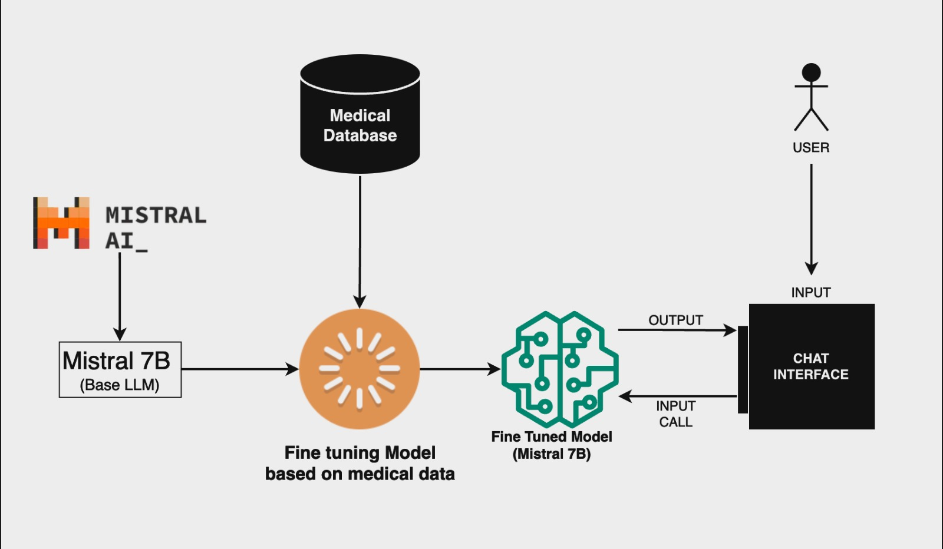
System Design & Implementation
Architecture

Slide 30
System Design & Implementation
The Phi-2 Model:
A transformer with 2.7 billion parameters is the Phi-2. The same data sources as Phi-1.5 were used to teach it, along with an additional data source made up of different fake NLP texts and censored websites (for training and security). In terms of performance against benchmarks measuring logical thinking, language understanding, and common sense, Phi-2 demonstrated near-best results for models with less than 13 billion parameters.This model was not refined through feedback from humans. This open source model aims to give the scientific community a free and unrestricted tiny model to explore critical safety concerns like controlling toxicity, comprehending social biases, and more.

Slide 31
System Design & Implementation
Mistral 7B:
Innovative attention methods including Sliding Window Attention (SWA) and Grouped Query Attention (GQA) are included in Mistral 7B. Larger batches and improved performance in real-time applications are made possible by GQA, which increases hell speed and lowers memory requirements during decoding. Large language models (LLM) have a general restriction that SWA aims to solve by handling longer sequences more effectively and at a lower computing cost. When these attention processes are combined, the Mistral 7B performance and efficiency are enhanced.Mistral 7B is available under the Apache 2.0 license and comes with a benchmark application that can be easily deployed using the vLLM inference server and SkyPilot to local computers or cloud platforms like AWS, GCP, or Azure. Hugging Face integration is more seamless, and the Mistral 7B is made to make fine-tuning for different jobs easier. The improved chat model Mistral 7B outperforms Llama 2 13B - Chat with its exceptional performance and versatility. Mistral 7B seeks to help the community produce more reasonably priced, effective, and superior models by striking a compromise between high performance and efficiency for big language models.

Slide 32
System Design & Implementation
StableLM Zephyr 3B :
The 3 billion-parameter compact neural network model StableLM Zephyr 3B is designed to produce text on a variety of devices with efficiency and adaptability. With 60% fewer parameters than similar 7B models, it produces precise results without the need for sophisticated gear.The template, which is available under a non-commercial license, emphasizes asking questions and according to directions. The training process, which draws inspiration from the Zephyr 7B architecture, entails adjusting and personalizing training data resources based on users' preferences.The StableLM Zephyr 3B scores better in benchmarks than larger versions in terms of linguistic accuracy, consistency, and relevance. Its lightweight performance is available outside of sophisticated systems and is appropriate for a range of text creation activities, such as content creation and summarizing. All things considered, the StableLM Zephyr 3B provides a strong yet effective solution that prioritizes adaptability in practical applications across a range of computing settings. Its small form factor attempts to increase the number of people who can create effective text.

Slide 33
System Design & Implementation
Fine Tuning:
In the context of machine learning, fine-tuning is the act of modifying a pre-trained model's parameters to make it more appropriate for a particular task or domain. A model might not function as well for a more specialized or nuanced task if it was first trained on a big dataset for a generic purpose. This pre-trained model is fine-tuned by retraining it on a smaller, task-specific dataset.
To better match the complexity of healthcare data and diagnostic requirements, fine-tuning the AI-based diagnostic system described earlier may entail modifying the model's parameters, which may include weights and biases. This procedure enhances the model's functionality, precision, and efficacy in managing particular medical diagnsotics.
Fine-tuning is an essential component of our two-pronged strategy to building our sophisticated healthcare AI system, balancing Natural Language Processing (NLP) and Machine Learning (ML). This methodical approach is particularly important when working with Mistral, our Large Language Model (LLM), since it enhances the model's ability to go beyond traditional communication boundaries. In order to provide a thorough comprehension of user inquiries and to customize Mistral's contextualization to the complexities of healthcare interactions, fine-tuning is essential. The process of fine-tuning Mistral is crucial to improving its complex understanding of medical intricacies as we incorporate it into our chatbot, resulting in more sophisticated and productive user interactions. Fine-tuning goes beyond Mistral and involves our ML component as well, honing the model's recognition skills of complex patterns and relationships in medical data.

Slide 34
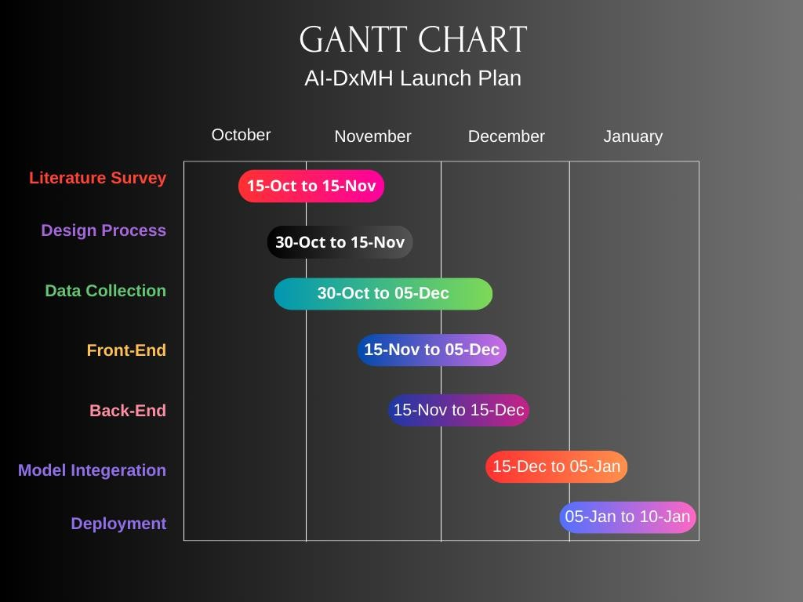
Timeline of Project
(GANTT CHART)

Slide 35
Outcomes
Available health services: Improved accessibility: Adopting an AI-based diagnostic model will increase the availability of health services, especially in remote and underserved areas where doctor shortages are common. The system allows people in such areas to receive timely diagnostic knowledge without the need for immediate physical contact with health professionals.
Remote Monitoring: The model enables remote monitoring of health facilities, allowing people to enter their symptoms and receive diagnostic recommendations. This not only reduces the burden on local health facilities, but also ensures that people in remote areas can benefit from medical knowledge without having to travel long distances.
Timely diagnosis: The introduction of an AI-based diagnostic system enables quick and timely diagnosis of everyday acute diseases such as cold and flu. Users can enter their symptoms into the system, and the rapid analysis model provides rapid feedback, which allows treatment to begin faster.

Slide 36
Outcomes
Reduce health differences: Geographic independence: One of the important results is the reduction of health differences by providing consistent diagnostic services regardless of geographic location. This is particularly important in countries like India, where the disparity between urban and rural healthcare is clear.
Equitable access to information: An AI-based diagnostic tool ensures that people have equal access to accurate and timely health information regardless of their location. This will help address disparities in access to and outcomes of health care between urban and rural populations.

Slide 37
Outcomes
Scalable Telemedicine Solutions: Overcoming Previous Challenges: Developing scalable telemedicine solutions augmented with artificial intelligence will address the challenges of previous telemedicine efforts. The diagnostic model based on artificial intelligence increases the efficiency and reliability of telemedicine services, making them even more scalable and sustainable. Better coverage: Scalable telemedicine solutions can reach larger populations even in remote areas. The integration of AI will not only improve diagnostic accuracy, but also enable more people to access telehealth services, leading to a wider impact. Improved Healthcare Infrastructure: Integrating AI into telemedicine will improve healthcare infrastructure, making it more adaptable to the changing needs of a growing and diverse population.

Slide 38
Outcomes
Ease of use: User-friendly interfaces: Development of user-friendly interfaces ensures that individuals, including those with limited technical knowledge, can easily interact with the AI-based diagnostic tool. It improves the accessibility of the health system by making it inclusive and user-centric. Accessibility for all: A focus on ease of use is critical to ensure that the benefits of an AI-based diagnostic system are available to a wide range of users. This inclusion includes people with varying levels of technical literacy, enabling them to benefit from health services.

Slide 39
Outcomes
Public health awareness: Dissemination of information: Implementation of an AI-based diagnostic system increases public health awareness by providing accurate information about common diseases and symptoms. By interacting with the tool, users can gain insight into various health conditions, promoting a proactive approach to health care.
Prevention and early intervention: Greater awareness facilitates preventive measures and early interventions, thus reducing the overall burden on the health system. Users have the right to make informed decisions about their health, leading to healthier lifestyles and less preventable disease.

Slide 40
Outcomes
Data-Driven Insights:
Population Health Analysis:
AI-based diagnostic system produces valuable information about common diseases, symptoms, and diagnostic patterns. This knowledge advances the analysis of population health and enables health professionals and decision makers to make informed decisions about public health planning and resource allocation.
Evidence-based decision-making:
Evidence-based insights enable evidence-based decision-making in health care, which promotes a more proactive and effective approach to solving public health problems. This ensures that activities are adapted to the specific needs of the population.

Slide 41
Results Obtained
Training:
As mentioned in CHAPTER-6, we considered three models namely;
Phi – 2 (2.7B Parameter)
Mistral (7B Parameter)
StableLM Zeypher (3B Parameter, Instruct Model)
To have a Standardized Training metric we used Q-LoRA Method from the LoRA

Slide 42
Results Obtained
LoRA Configuration (used for all Models)
We have to apply some preprocessing to the model to prepare it for training. For that we use the prepare_model_for_kbit_training method from PEFT.
from peft import prepare_model_for_kbit_training
model.gradient_checkpointing_enable()
model = prepare_model_for_kbit_training(model)
def print_trainable_parameters(model):
"""
Prints the number of trainable parameters in the model.
"""
trainable_params = 0
all_param = 0
for _, param in model.named_parameters():
all_param += param.numel()
if param.requires_grad:
trainable_params += param.numel()
print(
f"trainable params: {trainable_params} || all params: {all_param} || trainable%: {100 * trainable_params / all_param}"
)

Slide 43
Results Obtained
Now we define the LoRA config:
The values used in the QLoRA paper were r=64 and lora_alpha=16, and these are said to generalize well, but we will use r=32 and lora_alpha=64 so that we have more emphasis on the new fine-tuned data while also reducing computational complexity.
from peft import LoraConfig, get_peft_model
config = LoraConfig(
r=32,
lora_alpha=64,
target_modules=[
"q_proj",
"k_proj",
"v_proj",
"o_proj",
"gate_proj",
"up_proj",
"down_proj",
"lm_head",
],
bias="none",
lora_dropout=0.05, # Conventional
)
model = get_peft_model(model, config)
print_trainable_parameters(model)
Note – “Play around with r and lora_alpha for finding the optimal setting of r & lora_alpha for each model”

Slide 44
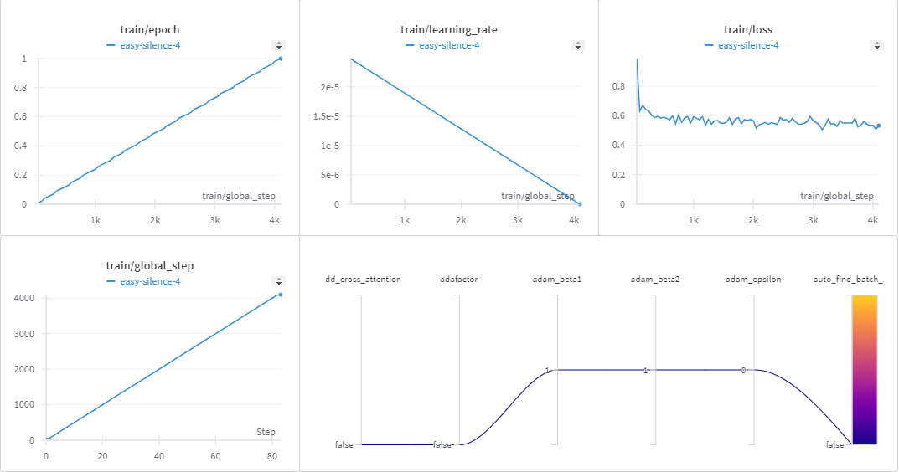
Results Obtained
Training Report: StableLM Zeypher 3B
9.3.1 While Training

Slide 45
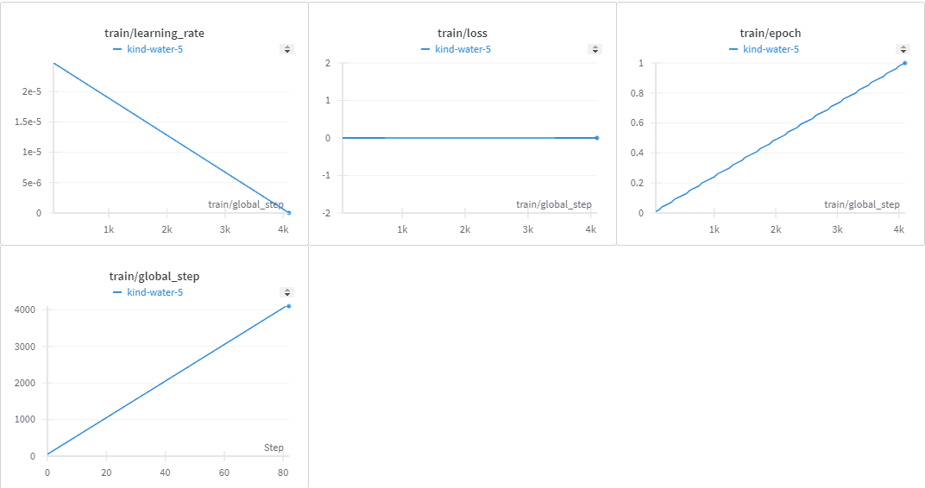
Results Obtained
Training Report: Phi – 2 (2.7 B)
9.4.1 Phi – 2 Learning
9.4.1 Phi – 2 Learning

Slide 46
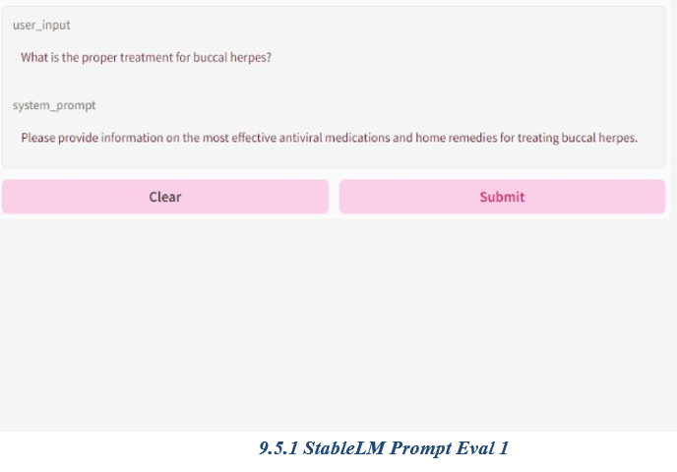
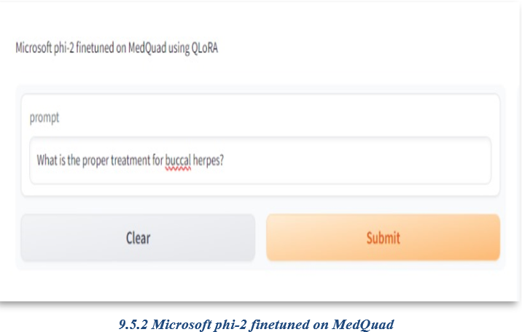
Results Obtained
Prompt Evaluation:

Slide 47
Conclusion
An initiative to introduce an AI-based diagnostic tool in India has the potential to transform healthcare access, especially in underserved areas that face ongoing challenges with limited access to medical professionals. The intended outcomes include a broad set of improvements that together will shape the healthcare landscape to be more inclusive and efficient.
Tackling the shortage of doctors and improving accessibility:
The main objective of the initiative is to improve access to health services, especially in remote areas suffering from a lack of doctors. Offering a virtual "doctor”; The system aims to bridge the gap in medical services by providing timely and accurate diagnostic knowledge to residents of smaller towns and villages
Quick and timely diagnosis for better health outcomes:
Quick and timely diagnosis of common illnesses such as colds and flu are a key component of the initiative. This ensures that people receive prompt medical care that improves health outcomes. Early intervention becomes a key preventive healthcare strategy that reduces disease severity and reduces the overall burden on the healthcare system.
Reducing health care disparities:
A notable result is a reduction in health disparities, which underscores the goal of achieving equitable health care for all regardless of geographic location. The initiative aims to break down barriers and provide consistent diagnostic services to individuals, whether they live in urban centers or remote villages.
Scalable telemedicine solutions for a connected healthcare system:
Developing scalable telemedicine solutions with artificial intelligence will not only solve previous scalability issues, but also lay the foundation for a more connected and digitally enabled healthcare system. This innovation promises to reach a larger population and improve health care.

Slide 48
Conclusion
User-friendly user interfaces for comprehensive health communication:
User-friendly user interfaces for an AI-based diagnostic tool are crucial when health communication is accessible to people at different levels. This inclusiveness ensures that a broad user base can take advantage of the tool, encouraging widespread adoption and use.
Health benefits and data insights:
In addition to individual health benefits, the initiative promotes public health awareness and practices. Increased awareness of common diseases and symptoms promotes a culture of preventive healthcare. In addition, building data-driven insights into common diseases supports public health planning by enabling targeted allocation of resources and intervention strategies.
Reliability and integration with existing systems:
The reliability of medical information provided by an AI-based tool is critical to building user trust. Integration with existing healthcare systems ensures a seamless healthcare experience by facilitating disease tracking and monitoring. This collaborative approach is consistent with the broader goals of strengthening health infrastructure.
Encouraging greater adoption of telemedicine:
The initiative plays a key role in promoting greater adoption of telemedicine in line with emerging trends in digital health. Such a change in health services not only increases the scope of health services, but also reflects a positive response to technological developments in the field. Integrating AI in healthcare will not only improve the diagnostic process but also lay the foundation for a more sustainable, accessible and patient-friendly healthcare ecosystem in the country. This initiative is a significant step towards democratizing access to quality medical services for all, as technology continues to play a key role in shaping the future of healthcare.

Slide 49
References
[1]. Zhou, J., Chen, X., & Gao, X. (2023) ‘Path to Medical AGI: Unify Domain-Specific Medical LLMs with the Lowest Cost’. Retrieved from https://arxiv.org/abs/2306.10765v1
[2]. Shah, N. H., Entwistle, D., & Pfeffer, M.A. (2023). ‘Creation and Adoption of Large Language Models in Medicine’. JAMA, 330, 866–869. doi:10.1001/jama.2023.14217
[3]. Lahat, A., Shachar, E., Avidan, B., Glicksberg, B., & Klang, E. (2023). ‘Evaluating the Utility of a Large Language Model in Answering Common Patients’ Gastrointestinal Health-Related Questions: Are We There Yet?’ Diagnostics, 13, 1950. doi:10.3390/DIAGNOSTICS13111950/S1
[4]. Shoham, O. B., & Rappoport, N. (2023). ‘CPLLM: Clinical Prediction with Large Language Models’. Retrieved from https://arxiv.org/abs/2309.11295v1
[5]. Reese, J. T., Danis, D., Caulfied, J. H., Casiraghi, E., Valentini, G., Mungall, C. J., & Robinson, P. N. (2023). ‘On the limitations of large language models in clinical diagnosis’. medRxiv. doi:10.1101/2023.07.13.23292613
[6]. Bitkina, O. V., Park, J., & Kim, H. K. (2023). ‘Application of artificial intelligence in medical technologies: A systematic review of main trends.’ Digital Health, Vol. 9. doi:10.1177/20552076231189331

Slide 50
References
[7]. Kelly, C. J., Karthikesalingam, A., Suleyman, M., Corrado, G., & King, D. (2019). ‘Key challenges for delivering clinical impact with artificial intelligence’. BMC Medicine, 17, 1–9. doi:10.1186/S12916-019-1426-2/PEER- REVIEW
[8]. Behara, K., Bhero, E., Agee, J. T., & Gonela, V. (2022). ‘Artificial intelligence in medical diagnostics: A review from a South African context.’ Scientific African, 17, e01360. doi:10.1016/J.SCIAF.2022.E01360
[9]. Zhang, Y., ; Weng, Y., Lund, J., Faust,O., Su, L., Acharya, R., … Lund, J. (2022). ‘Applications of Explainable Artificial Intelligence in Diagnosis and Surgery.’ Diagnostics 2022, Vol. 12, Page237, 12, 237. doi:10.3390/DIAGNOSTICS12020237
[10]. Kumar, Y., Koul, A., Singla, ·. Ruchi, Muhammad, ·., & Ijaz, F. (2023). ‘Artificial intelligence in disease diagnosis: a systematic literature review, synthesizing framework and future research agenda.’14, 8459–8486. doi:10.1007/s12652-021-03612-z
[11]. Su, L. X., Weng, L., Li, W. X., & Long, Y. (2023). ‘Applications and challenges of large language models in critical care medicine’. Zhonghua Yi Xue Za Zhi, 103, 2361– 2364. doi:10.3760/CMA.J.CN112137- 20230524-00847
[12]. Yang, R., Ting, Tan, F., Lu, W., Arun, Thirunavukarasu, J., … Ting, W. (8 2023). Large language models in health care: Development, applications, and challenges. Health Care Science, 2, 255–263. doi:10.1002/HCS2.61
[13]. Karabacak, M., & Margetis, K. (5 2023). Embracing Large Language Models for Medical Applications: Opportunities and Challenges. Cureus, 15. doi:10.7759/CUREUS.39305

Slide 51
Publication Details
About IJCRT :
Scholarly open access journals, Peer-reviewed, and Refereed Journals, Impact factor 7.97 (Calculate by google scholar and Semantic Scholar | AI-Powered Research Tool) , Multidisciplinary, Monthly, Indexing in all major database & Metadata, Citation Generator, Digital Object Identifier(DOI) | UGC Approved Journal No: 49023 (18)
Registration ID : IJCRT_249308
Paper ID : IJCRT2401211
Title of Paper : AI-DxMH - Artificial Intelligence Diagnosis for Modern Health
Impact Factor : 7.97 (Calculate by Google Scholar) | License by Creative Common 3.0
Publication Date : 09-January-2024 DOI :
Published in : Volume 12 | Issue 1 | January 2024
Page No : b689-b697
Published URL : http://www.ijcrt.org/viewfull.php?&p_id=IJCRT2401211
Authors : Vaishak G Kumar, Mohammed Fahad Pasha F, Abhilash Prusty, Dhrupath Rajeev, Gnanakumar Ganesan
Notification : UGC Approved Journal No: 49023 (18)

Slide 52
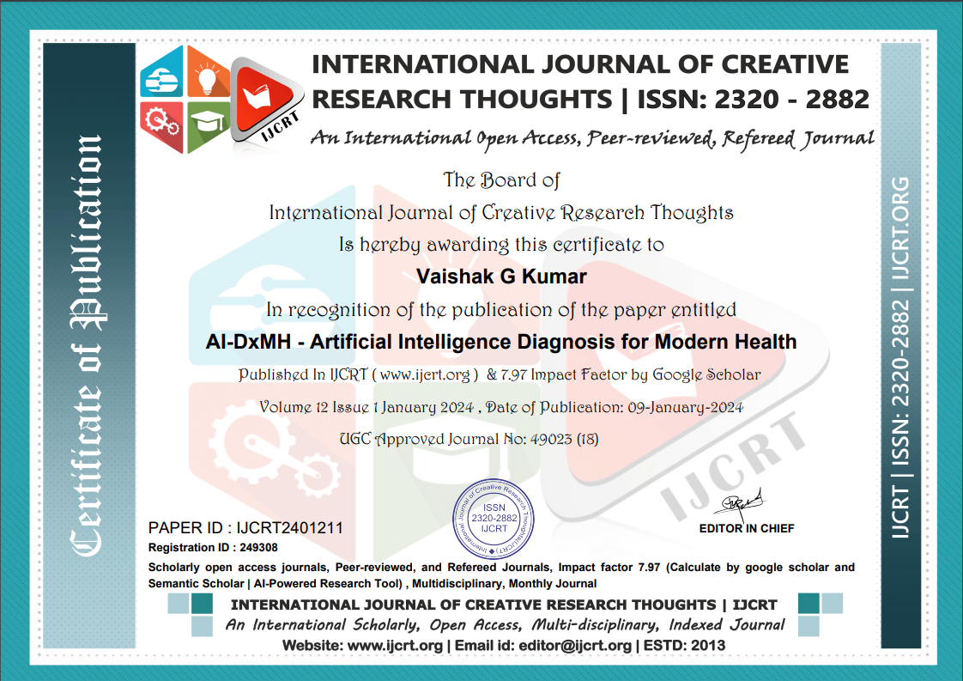
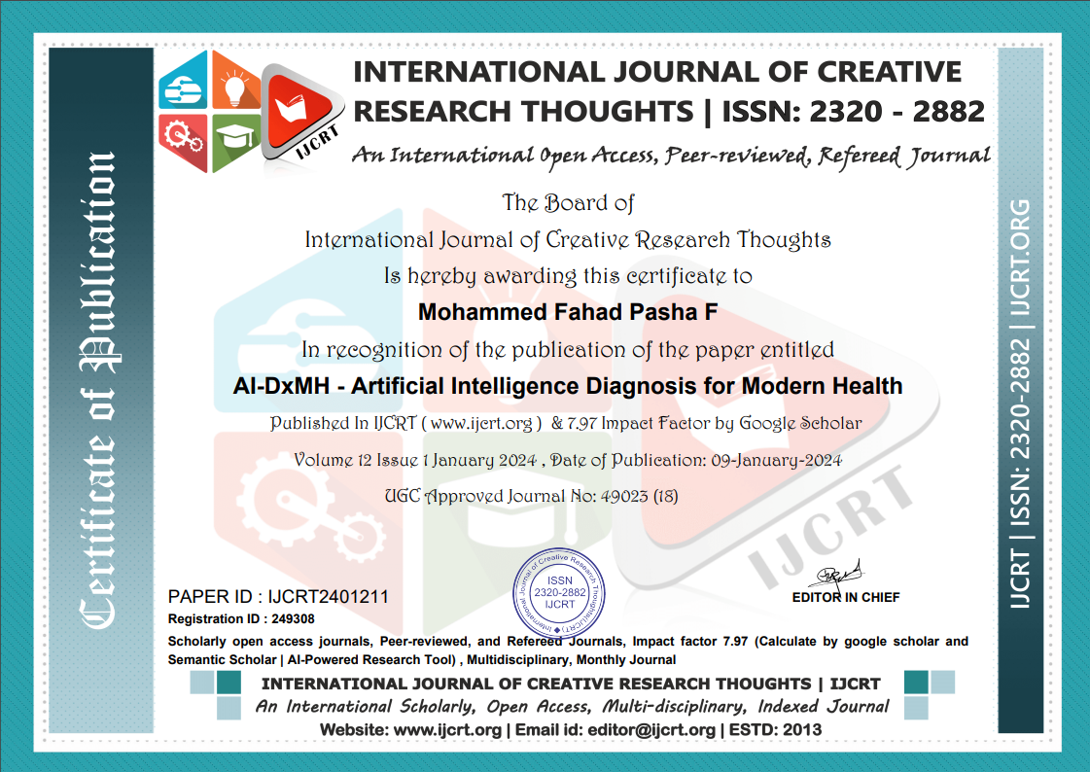
Publication Details

Slide 53
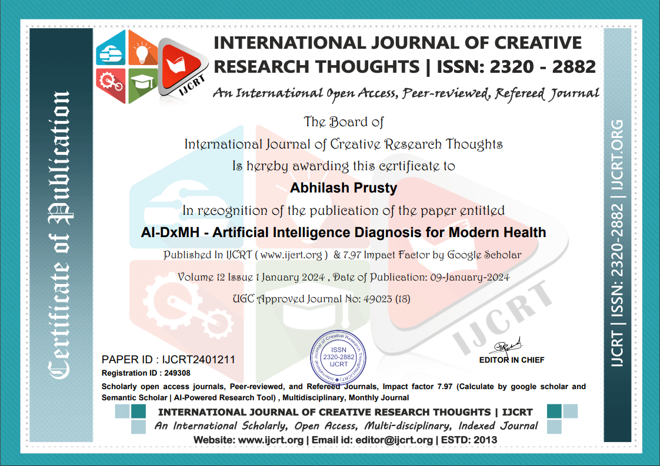

Publication Details

Slide 54

Publication Details

Slide 55

SDG

Slide 56
SDG
The Project work carried out here is mapped to SDG-3 Good Health and Well-Being.
The shortage of doctors and limited access to healthcare directly impacts the goal of ensuring healthy lives and promoting well-being. Developing an AI doctor could contribute to improving healthcare accessibility, providing timely and accurate diagnoses for common illnesses. The integration of technology in healthcare not only addresses immediate challenges but also supports the broader vision of ensuring healthy lives for all, emphasizing the importance of innovation and inclusivity in achieving sustainable health outcomes.

Slide 57

Thank You

